Slide 1
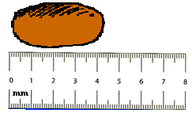
Chemistry – Sept 4, 2019
Get out Sigfig WS for
Hmk Check
P3 Challenge –
What is the length of this bean?
(Report your answer with the proper
number of decimal places/sigfigs.)
Visit the board for a close up
cm

Slide 2
Objectives and Agenda
Objectives
  To practice measuring length, mass and volume
  To learn about measuring with sigfigs from the equipment
  To understand density and practice density calculations
Agenda
  Homework Review (Matching and Sigfig WS)
  Density
  Measurement Lab Activity

Slide 3
Homework Review
Matching Worksheet Answers: Check yours and ask questions for clarification.
1. H 9. E A. 5 I. 11
2. J 10. C B. 12 J. 2
3. O 11. I C. 10 K. 7
4. L 12. B D. 15 L. 4
5. A 13. M E. 9 M. 13
6. F 14. G F. 6 N. 8
7. K 15. D G. 14 O. 3
8. N H. 1

Slide 4
Homework Review
Sigfig Worksheet Answers: Check yours and ask questions for clarification.
1. a) 3 b) 4 c) 3 d) 2 e) 2 f) 1 g) 3 h) 4 i) 5
2. a) 5.49 x 10⁶ m or 5,490,000 m
b) 0.0134793 mL
c) 31, 950 cm²
d) 192.67 m²
e) 790 cm
f) 3.89278 x 10⁸ J or 389,278,000 J
g) 225,834.8 cm³

Slide 5
Homework Review
Sigfig Worksheet Answers: Check yours and ask questions for clarification.
3. a) 48,825 cm² → 49,000 cm² or 4.9 x 10⁴ cm² Round to 2 sigfig
b) 3.134 kg/L → 3.1 kg/L Round to 2 sigfig
c) 12.29166666 L/s → 12.3 L/s Round to 3 sigfig
d) 166,525.2 cm² → 170,000 cm² or 1.7 x 10⁵ cm² Round to 2 sigfig
e) 40.763492 m³ → 41 m³ Round to 2 sigfig
f) 3.129555 g/cm³ → 3.1296 g/cm³ Round to 5 sigfig

Slide 6
Homework Review
Sigfig Worksheet Answers: Check yours and ask questions for clarification.
4. a) 90.225 J → 90.2 J Round to 1 d.p.
b) 0.0064 m → 0.006 m Round to 3 d.p
c) 934 g → 900 g Round to hundreds place
d) 31.0565 kPa → 31.1 kPa Round to 1 d.p.
e) 277.68 dL → 278 dL Round to ones place
f) 1794 kg → 1790 kg Round to tens place

Slide 7
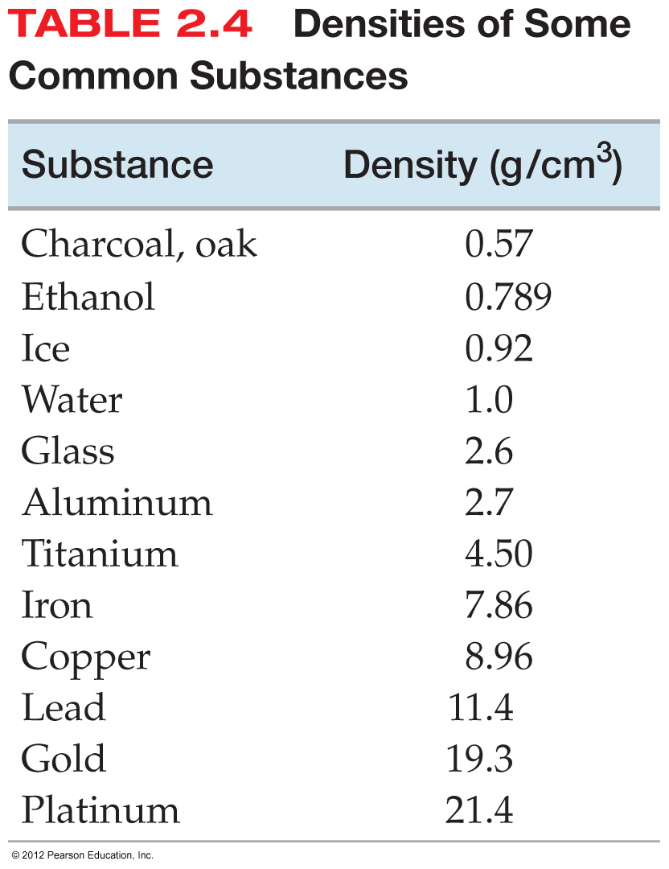
Density
Density is a characteristic physical property of a substance and is sometimes used to identify a substance.
Density is the mass of an item divided by its volume.
This table lists the density of many common substances.
Solids have the highest density, and liquids usually have lower density. Gases have the lowest densities by far, usually reported in g/L.
Density of water is 1.00 g/mL. Densities greater than 1 will sink. Densities less than 1 will float.

Slide 8
Understanding density
If density is color, a low density is a pale color, and a high density is a very intense color.
If two objects have the same mass, the smaller one is more dense.
If two objects are the same size, the heavier one is more dense.
1 kg
1 kg
1 kg
4 kg

Slide 9
Using the Density Formula
List the known quantities with their units. Let their units help you decide which quantity a value represents. There must be two known quantities.
Substitute these values into the formula.
Calculate the third variable.
Ex: A 1680 g object has a volume of 750 mL. What is the density of this object?

Slide 10
Lab Activity Overview
A. Measuring Length – Using three different types of rulers: 10 cm, 1 cm and 1 mm gradations.
B. Measuring Mass – Using three different types of balances: spring, triple beam, and electronic. For both spring and triple beam you may need to use a subtraction method to find the mass of an object.
  Subtracting a background reading is a very common lab procedure not just for measuring mass.
C. Measuring Liquid Volume – Liquids in graduated cylinders or beakers.
D. Measuring Solid Volume – First by measuring dimensions and using geometry. Second by using water displacement and another subtraction process.
Work in pairs, but split the measurement duties, and get both opinions for each.

Slide 11
Exit Slip - Homework
Exit slip – Put the room back in order the way you found it. If it’s not done, no one gets credit for the exit slip.
What’s Due? (Pending assignments to complete.)
  Measurement Lab Activity (time to complete on Fri)
  Density Worksheet
What’s Next? (How to prepare for the next day)
  Finish the Measurement Lab, Start using metric units
  Read p12-15

